Slide 1
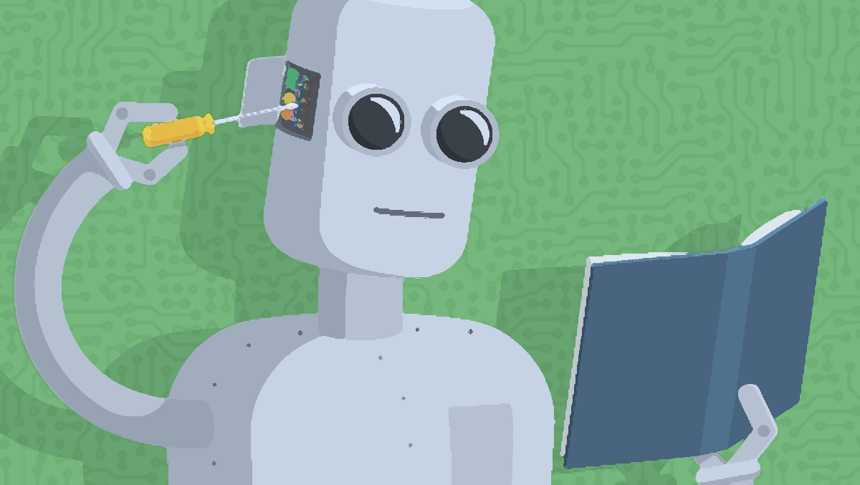
Image credit: towardsdatascience.com
MACHINE LEARNING
Instructor: Quang N. Tran
Main reference: Géron, A. (2019). Hands-on machine learning with Scikit-Learn, Keras, and TensorFlow.

Slide 2
SHOULD I LEARN MACHINE LEARNING (ML)?

Slide 3
Among 15 most in-demand tech skills:
ML and AI
Quality Assurance for ML Algorithms
Real-World ML Experience
– Forbes Technology Council, 2020

Slide 4
References
Burkov, A. (2019). The hundred-page machine learning book.
Géron, A. (2019). Hands-on machine learning with Scikit-Learn, Keras, and TensorFlow. O'Reilly Media.
Murphy, K. P. (2012). Machine Learning: A Probabilistic Perspective. MIT Press.
Swaroop, C. H. (2013). A Byte of Python.
Vũ, T. H. (2019). Machine Learning cơ bản.
Notes:
Ask student contact info

Slide 5
Course forum and materials
Q&A, give feedback: https://quang-tran-ute.mn.co/topics
Instructor’s email: quangtn@hcmute.edu.vn
Course materials: https://drive.google.com/drive/folders/1JXId8_BTzu0gh3_8q1qE7KDt1dqqbn20

Slide 6
Grading
Exercises (midterm): 50%
Project and presentation (final): 50%
➔ NO PLAGIARISM! VIOLATION WILL RESULT IN FAILING THE COURSE.

Slide 7
Bonus points
Answer questions, exercises during class meetings:
+ up to 0.5 point/one answer
Help other students by answering their questions on the forum:
+ up to 0.5 point/one answer
At the end of class sessions, random students submit their work on the current week’s exercises:
+ up to 1 point: if all exercises are done correctly
- up to 0.5 point: if no exercise is done
- up to 1 point: if student is absent

Slide 8
INTRODUCTION TO ML

Slide 9
How many times have you heard the term “machine learning”?
Give some examples of machine learning applications.
Do you know/can you guess what are the first ML applications?
What is machine learning (ML), in your opinion?

Slide 10
Early application (decades ago): Optical Character Recognition (OCR).
First mainstream ML: spam filter (1990s) affects millions of people
Nowaday, you may use ML everyday!

Slide 11

Machine learning is used for
Page ranking in search engines

Slide 12
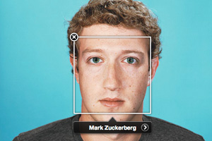
Machine learning is used for
Face recognizing in social networks
Image credit: sociable.co

Slide 13
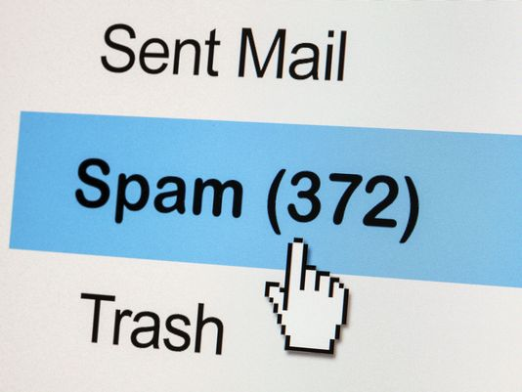
Machine learning is used for
Spam filtering in emails
Image credit: Getty Images/iStockphoto

Slide 14
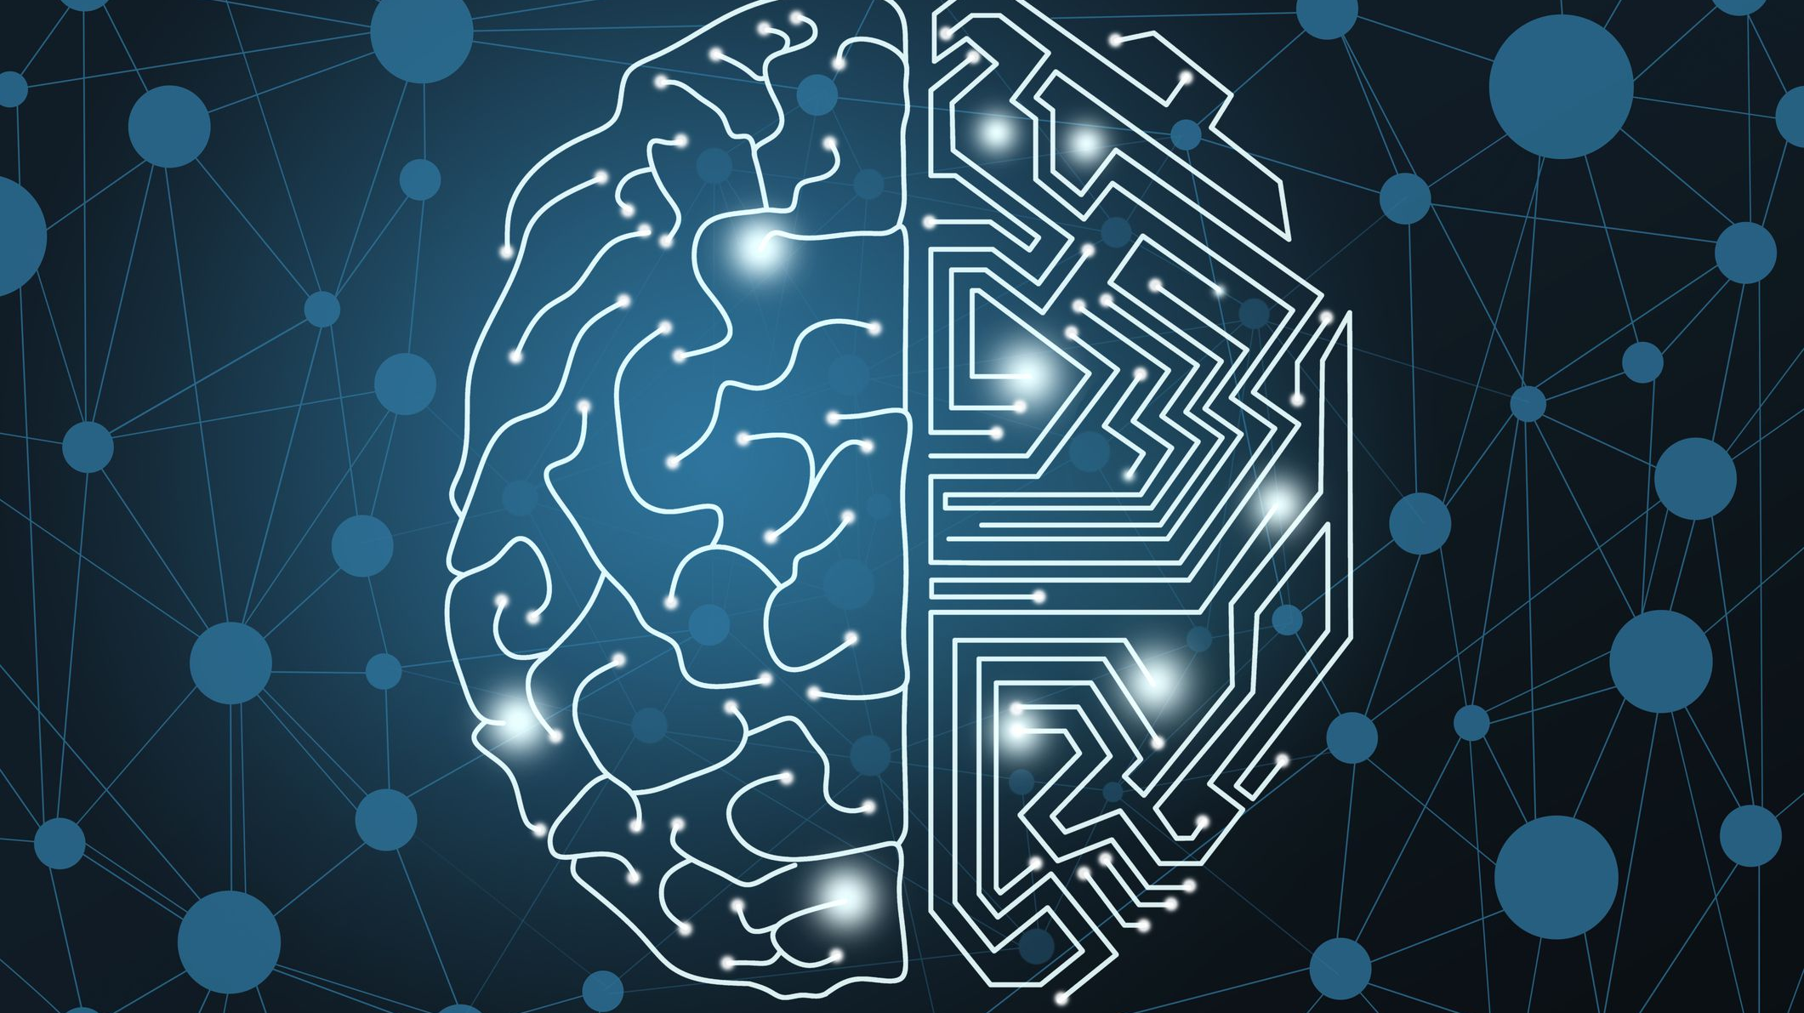
and for building AI systems
Image credit: Dong Wenjie/Getty Images

Slide 15
Machine learning was developed as a new capability for computers.
– Andrew Ng

Slide 16
WHAT IS MACHINE LEARNING?

Slide 17
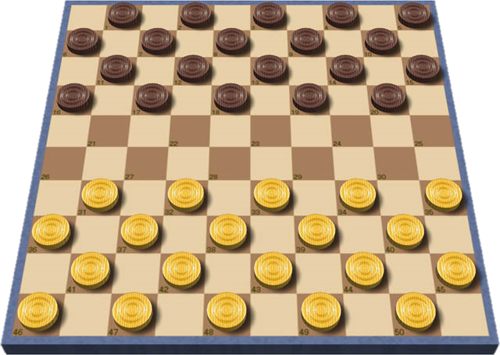
Machine learning definition
Machine learning is a field of study that gives computers the ability to learn from experience without being explicitly programmed.
(Samuel, 1959)
Checkers
Image credit: Michel32Nl

Slide 18
Machine learning definition
A computer program is said to learn from experience E with respect to some task T and some performance measure P, if its performance on T, as measured by P, improves with experience E.
(Mitchell, 1998)
Example: E, T, P in the checkers program.

Slide 19
A computer program is said to learn from experience E with respect to some task T and some performance measure P, if its performance on T, as measured by P, improves with experience E.
(Mitchell, 1998)
Suppose your email program watches which emails you do or do not mark as spam, and based on that learns how to better filter spam. What is the task T in this setting?
Classifying emails as spam or not spam.
Watching you label emails as spam or not spam.
The number (or fraction) of emails correctly classified as spam/not spam.
None of the above—this is not a machine learning problem.
Source: Andrew Ng

Slide 20


Suppose your email program watches which emails you do or do not mark as spam, and based on that learns how to better filter spam.
Training data (training set):
Sample/example/instance/data point:
Performance measure:

Slide 21
WHEN SHOULD WE USE ML?

Slide 22



Traditional programming
Build a spam filter using traditional programming techniques:
1.
2.
3.

Slide 23
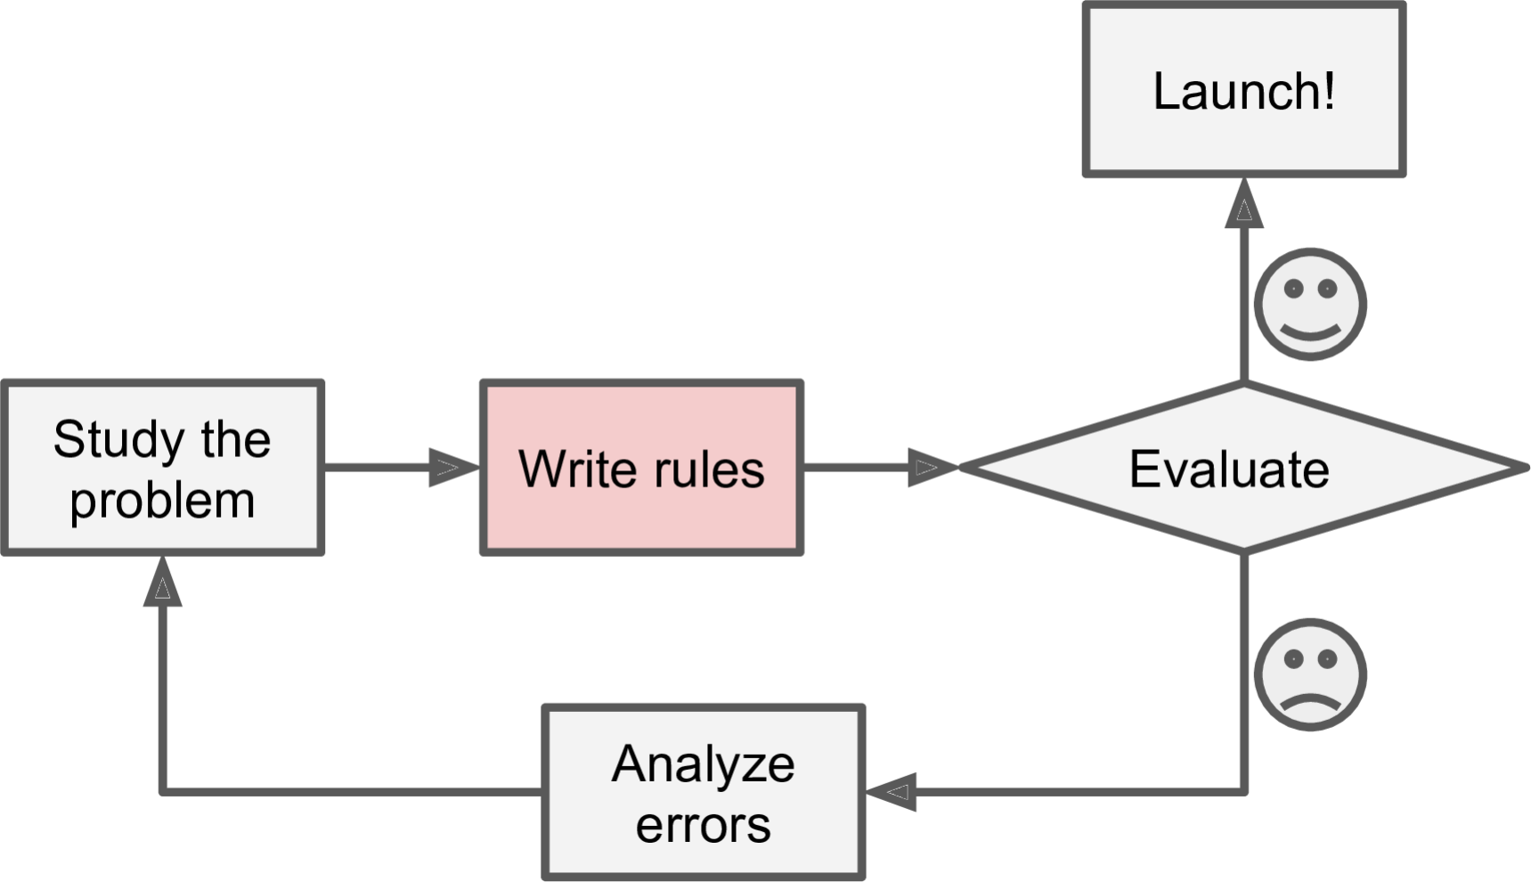



Traditional programming techniques
Source: (Géron, 2019)

Slide 24

ML techniques
A spam filter based on ML techniques:
➔

Slide 25
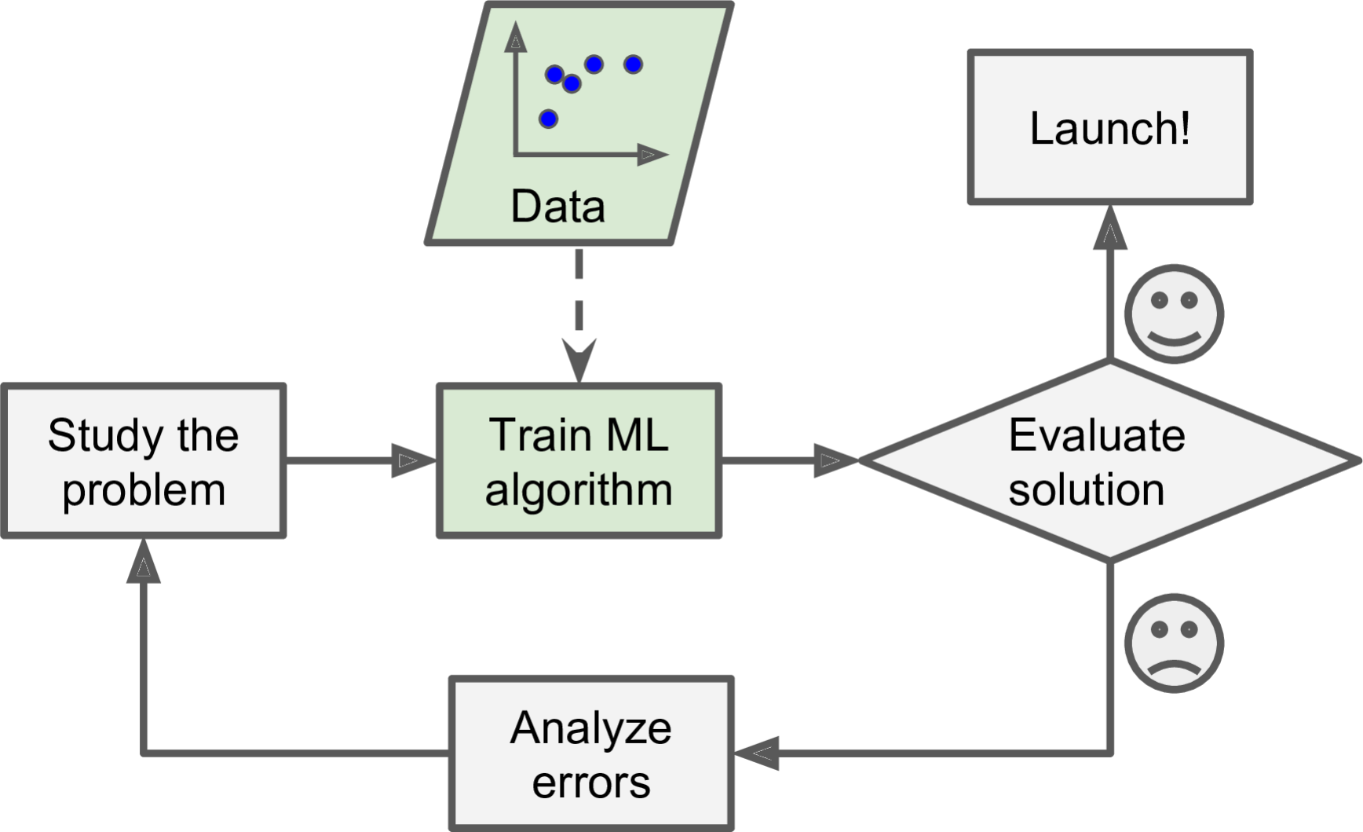




ML techniques: automatically learn rules
Source: (Géron, 2019)

Slide 26
ML techniques
If spammers change their writing style:
Traditional techniques:
ML approach:

Slide 27
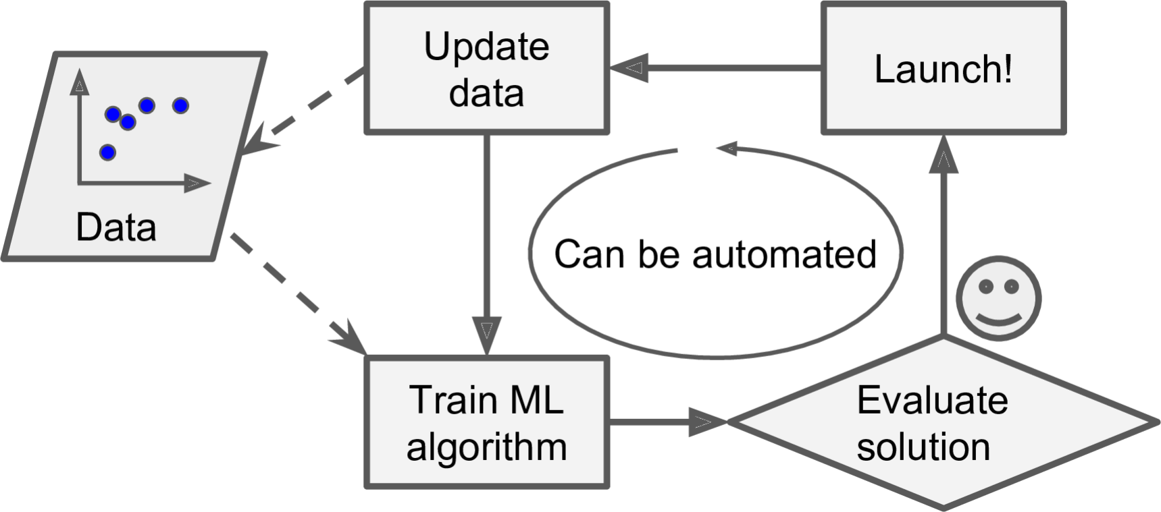



ML techniques: adaptive to change
Source: (Géron, 2019)

Slide 28
ML techniques: for complex problems

Slide 29

ML: can help humans learn

Slide 30
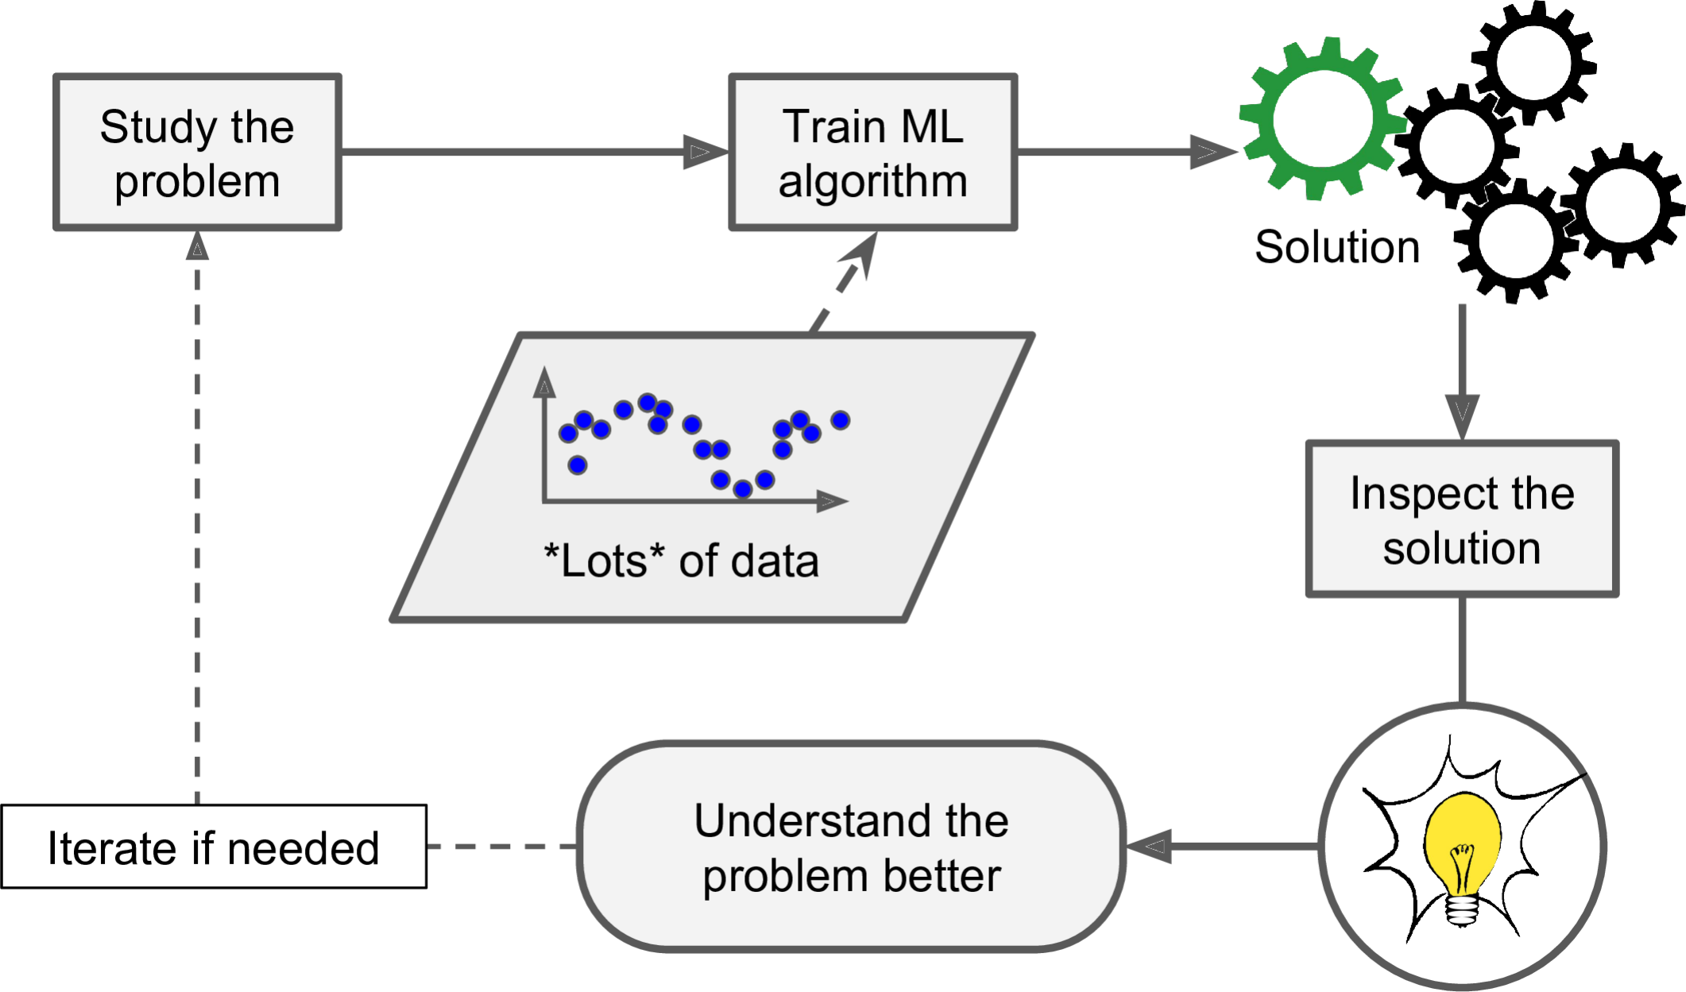









ML: can help humans learn
Source: (Géron, 2019)

Slide 31
In summary, ML is great for
Complex problems:
Changing environments
Getting insights:

Slide 32
TYPES OF ML

Slide 33

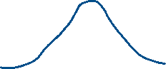

ML classification criteria
1. With human supervision or not?
supervised learning, unsupervised learning, semisupervised learning, and reinforcement learning
2. Learn on the fly or not?
online learning, batch learning
3. Use model or not?
instance-based learning, model-based learning

Slide 34
1. With human supervision or not?

Slide 35

With human supervision?
Supervised learning: use labeled data
Classification, e.g., spam filter, image classification

Slide 36
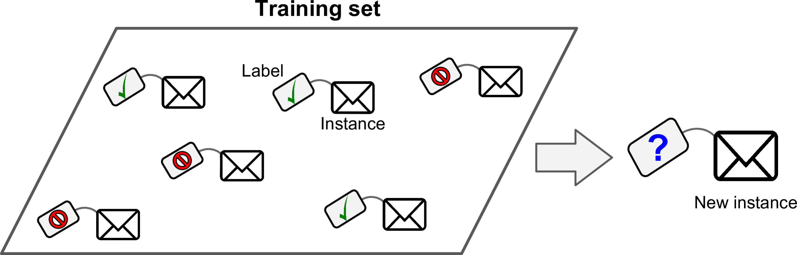



Source: (Géron, 2019)

Slide 37
Email classification
Image credit: Getty Images/iStockphoto

Slide 38
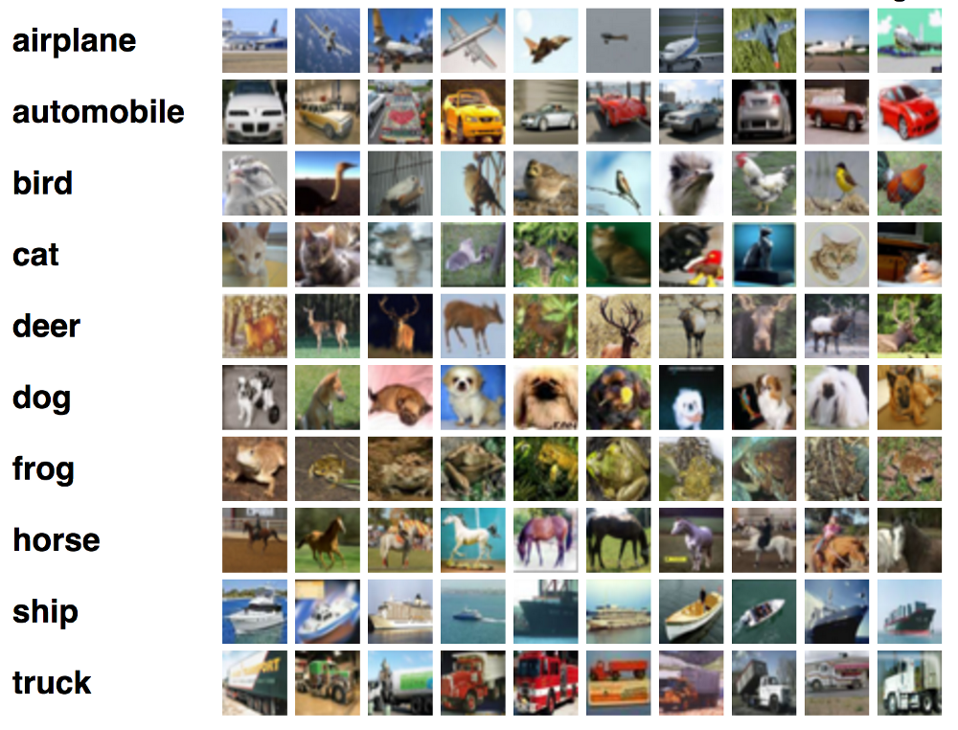

Image classification
Image credit: medium.com

Slide 39
With human supervision?
Supervised learning: use labeled data
Regression, e.g., housing price prediction, weather forecast

Slide 40
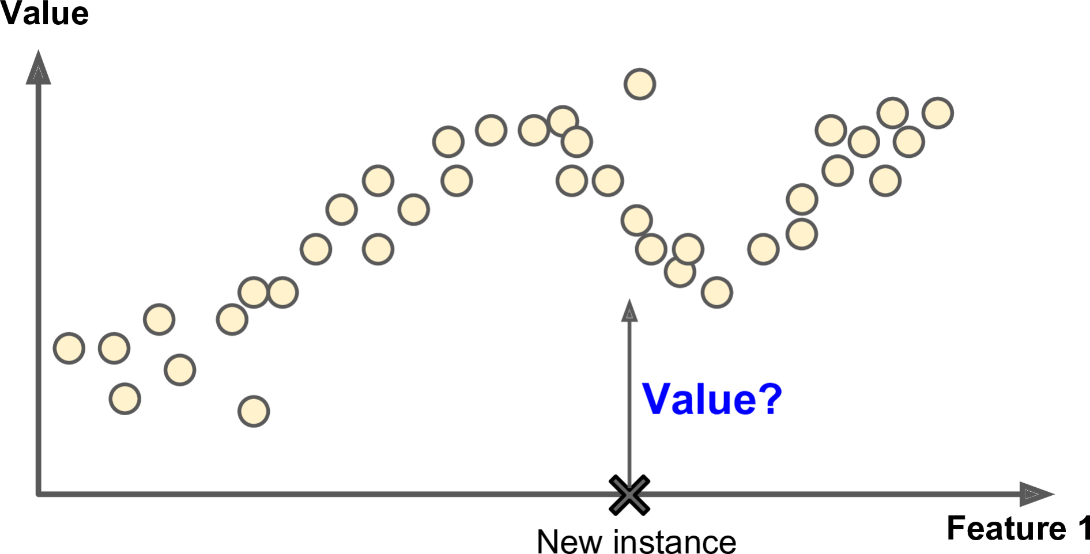
Features / attributes:
Source: (Géron, 2019)

Slide 41
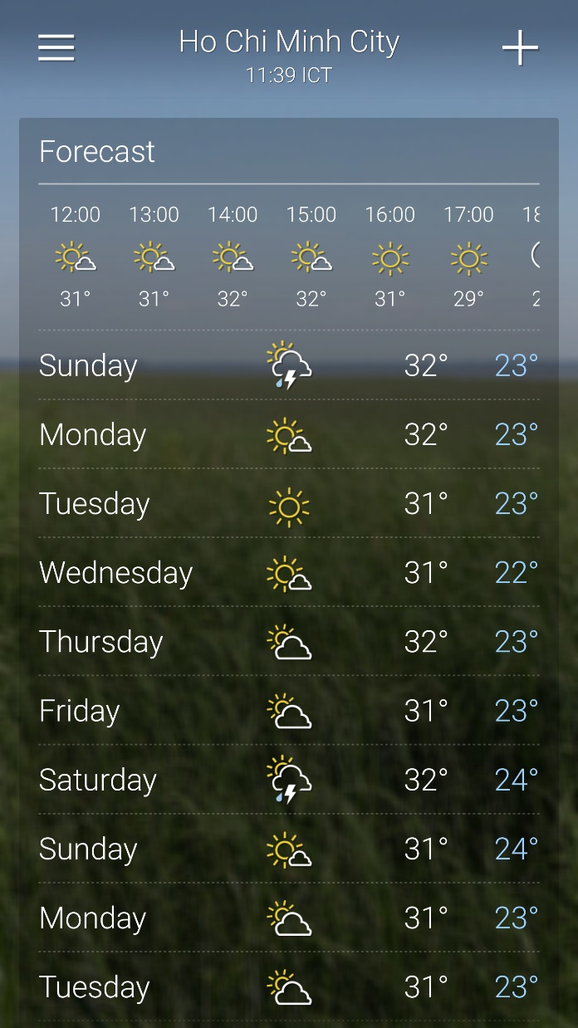
Weather forecast
Source: Yahoo weather

Slide 42
With human supervision?
Supervised learning: most important algorithms include
k-Nearest Neighbors
Linear Regression
Logistic Regression
Support Vector Machines (SVMs)
Decision Trees and Random Forests
Neural networks

Slide 43
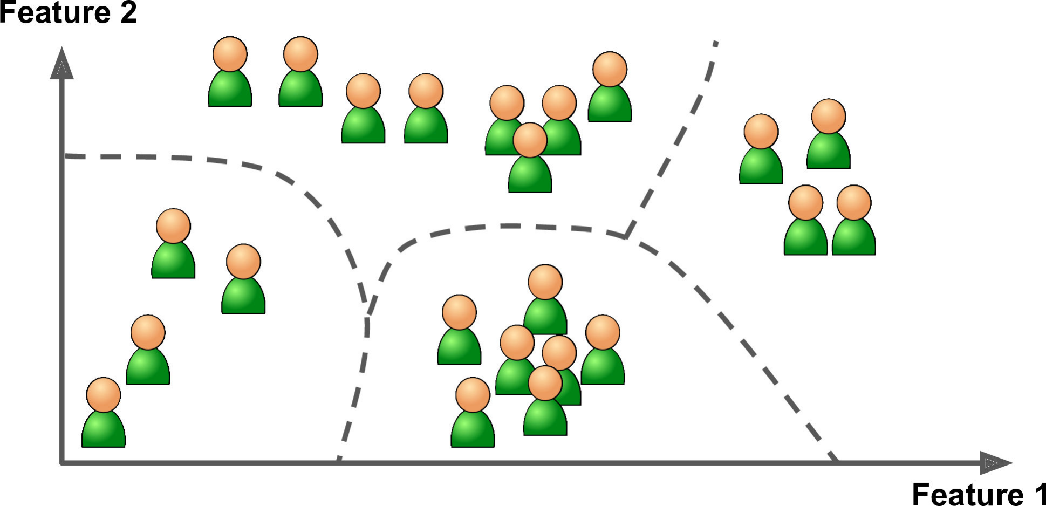
With human supervision?
Unsupervised learning: use unlabeled data
Clustering: most important algorithms include K-Means, DBSCAN, Hierarchical Cluster Analysis (HCA)
Source: (Géron, 2019)

Slide 44
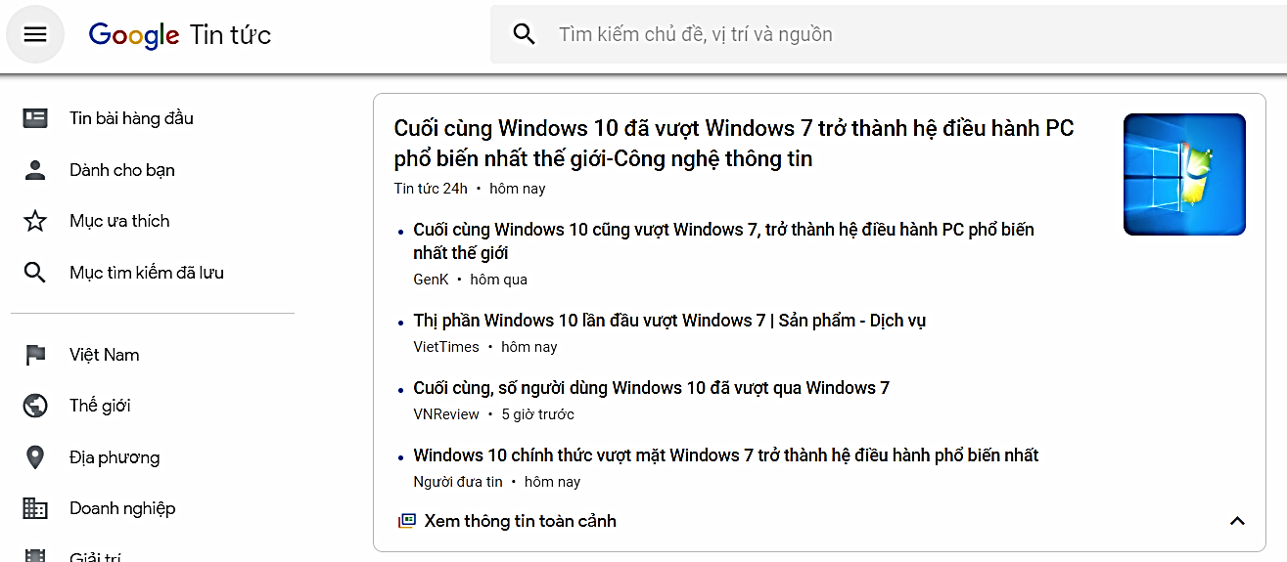
News clustering
news.google.com

Slide 45
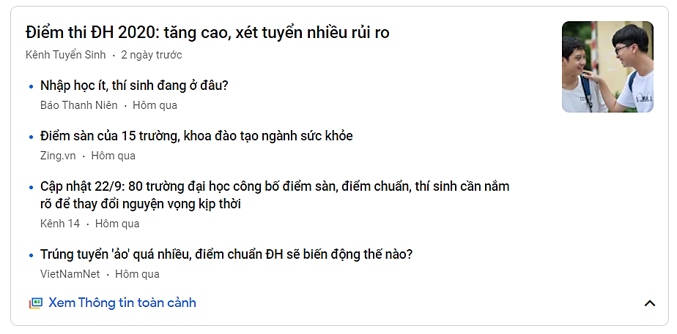
News clustering
news.google.com

Slide 46
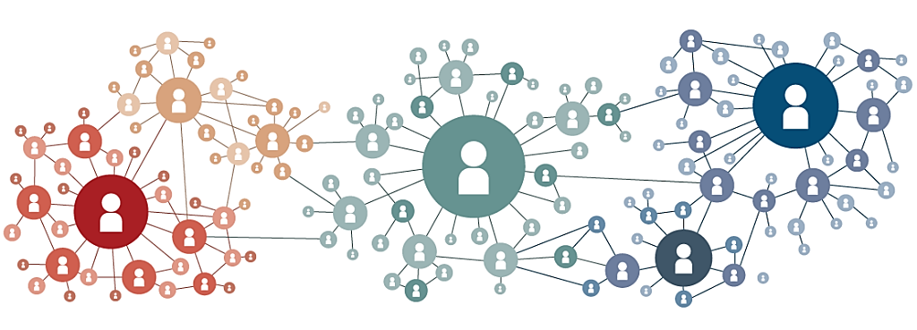
Social network analysis
Image credit: thismarketerslife.it

Slide 47
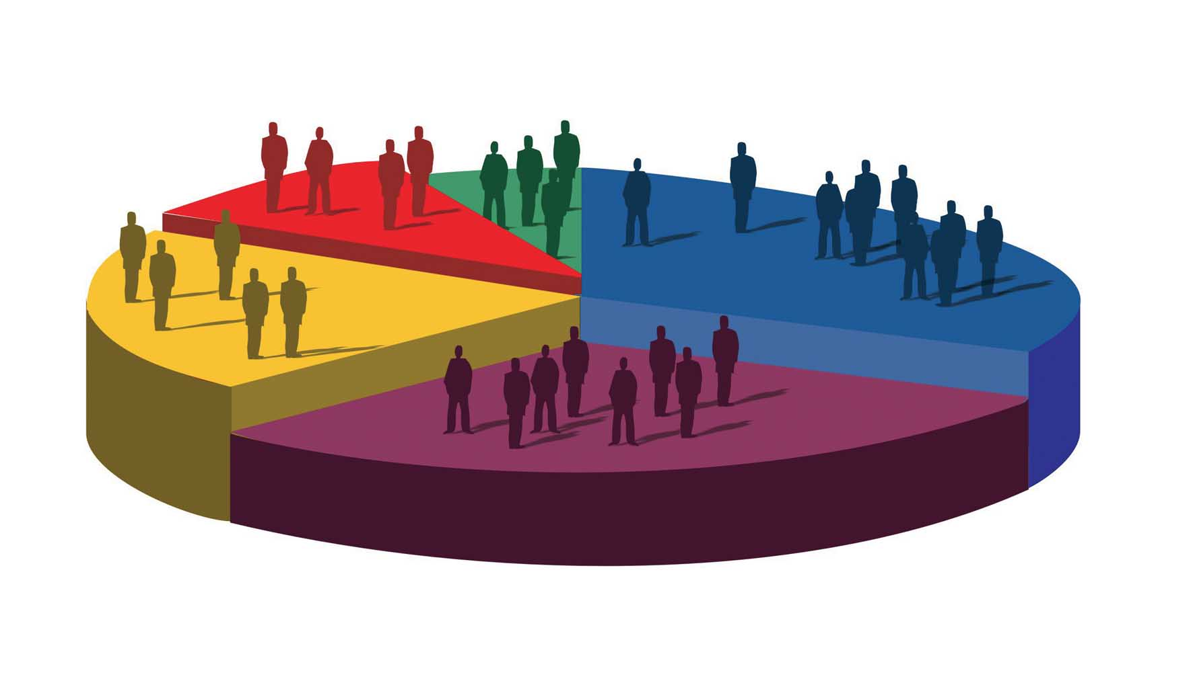
Market segmentation
Image credit: ilnordestquotidiano.it

Slide 48
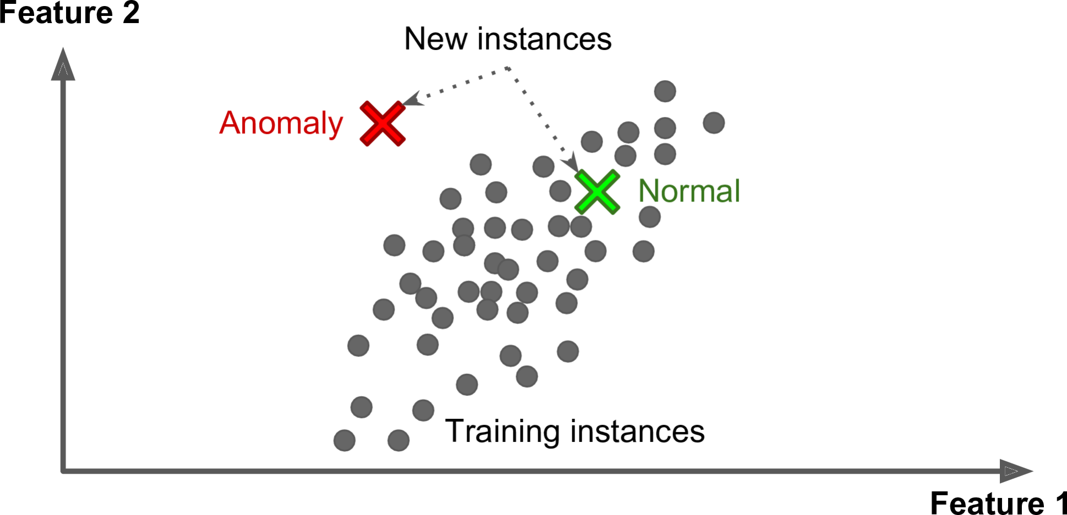
With human supervision?
Unsupervised learning: use unlabeled data
Anomaly detection: One-class SVM, Isolation Forest
Source: (Géron, 2019)

Slide 49

With human supervision?
Unsupervised learning: use unlabeled data
Dimensionality reduction: Principal Component Analysis (PCA), Locally-Linear Embedding (LLE), t-distributed Stochastic Neighbor Embedding (t-SNE)
Association rule learning: Apriori, Eclat

Slide 50

With human supervision?
Reinforcement learning: agents are taught using rewards.
Examples: robots learn to walk, DeepMind’s AlphaGo
Source: (Géron, 2019)

Slide 51
2. Learn on the fly or not?

Slide 52
Learn on the fly?
Batch learning: [exercise]
Online learning: [exercise]

Slide 53
3. Use model or not?

Slide 54
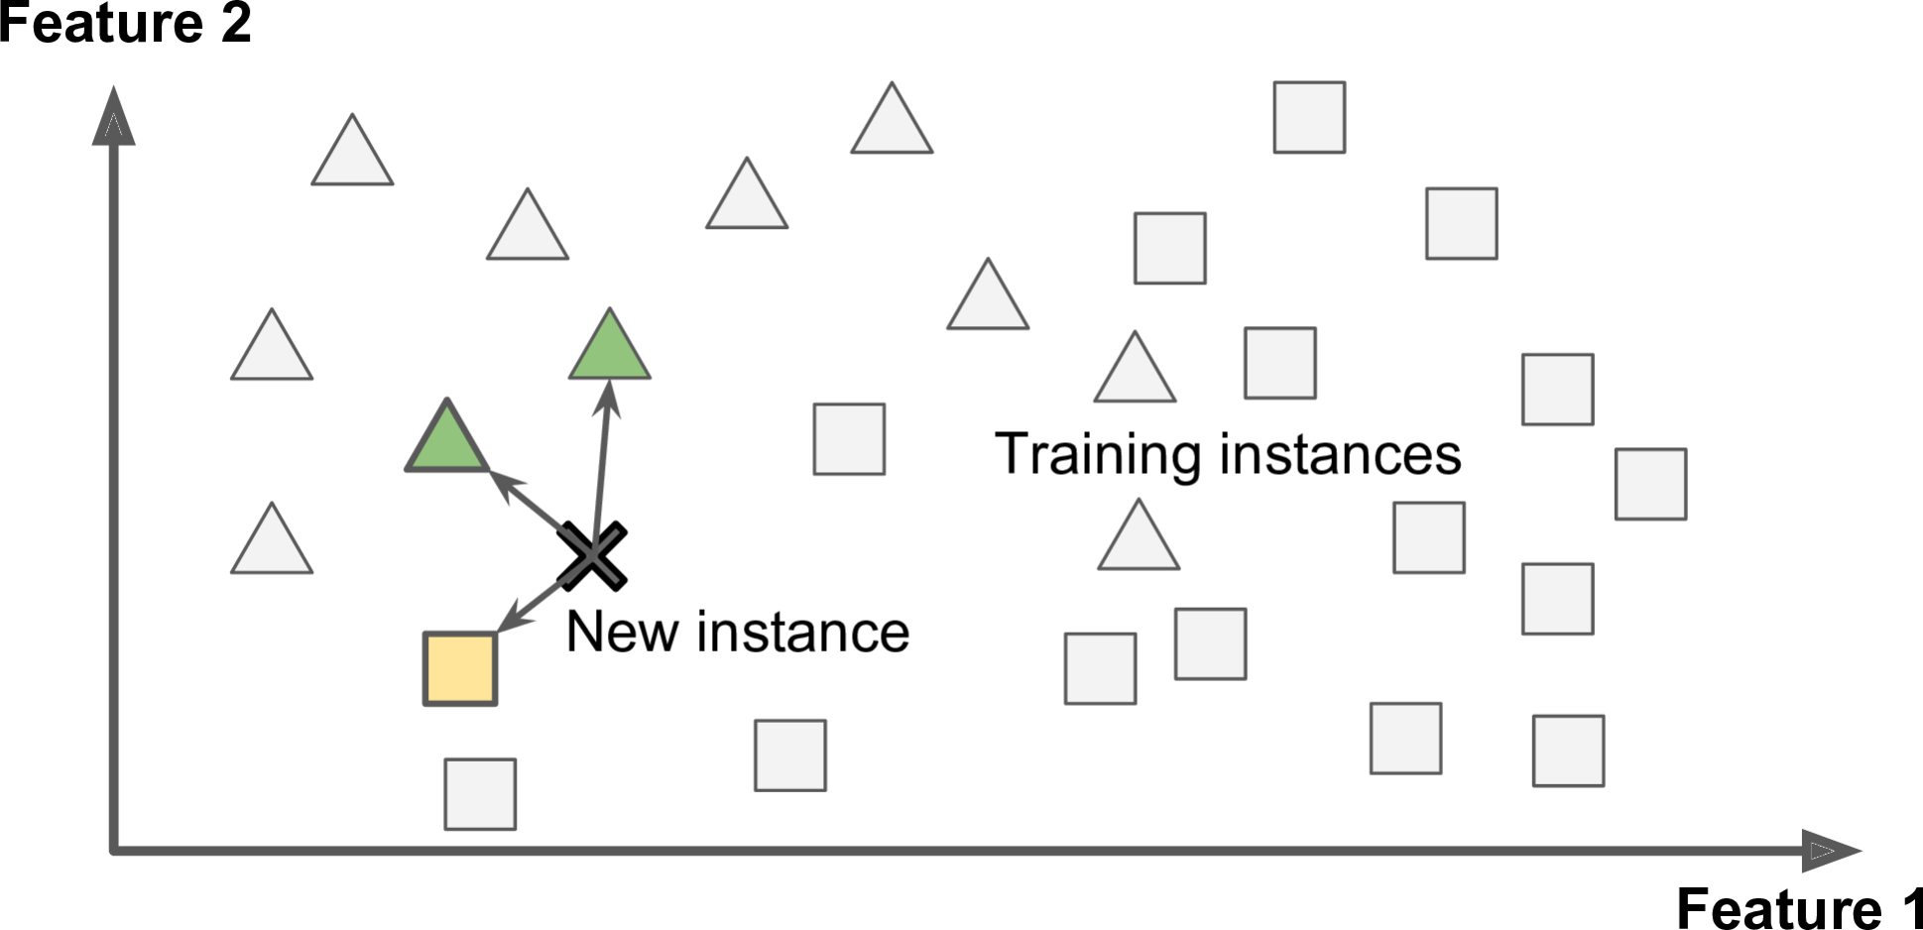
Use model?
Instance-based learning: compares new data to the learned examples using a similarity measure.
Source: (Géron, 2019)

Slide 55
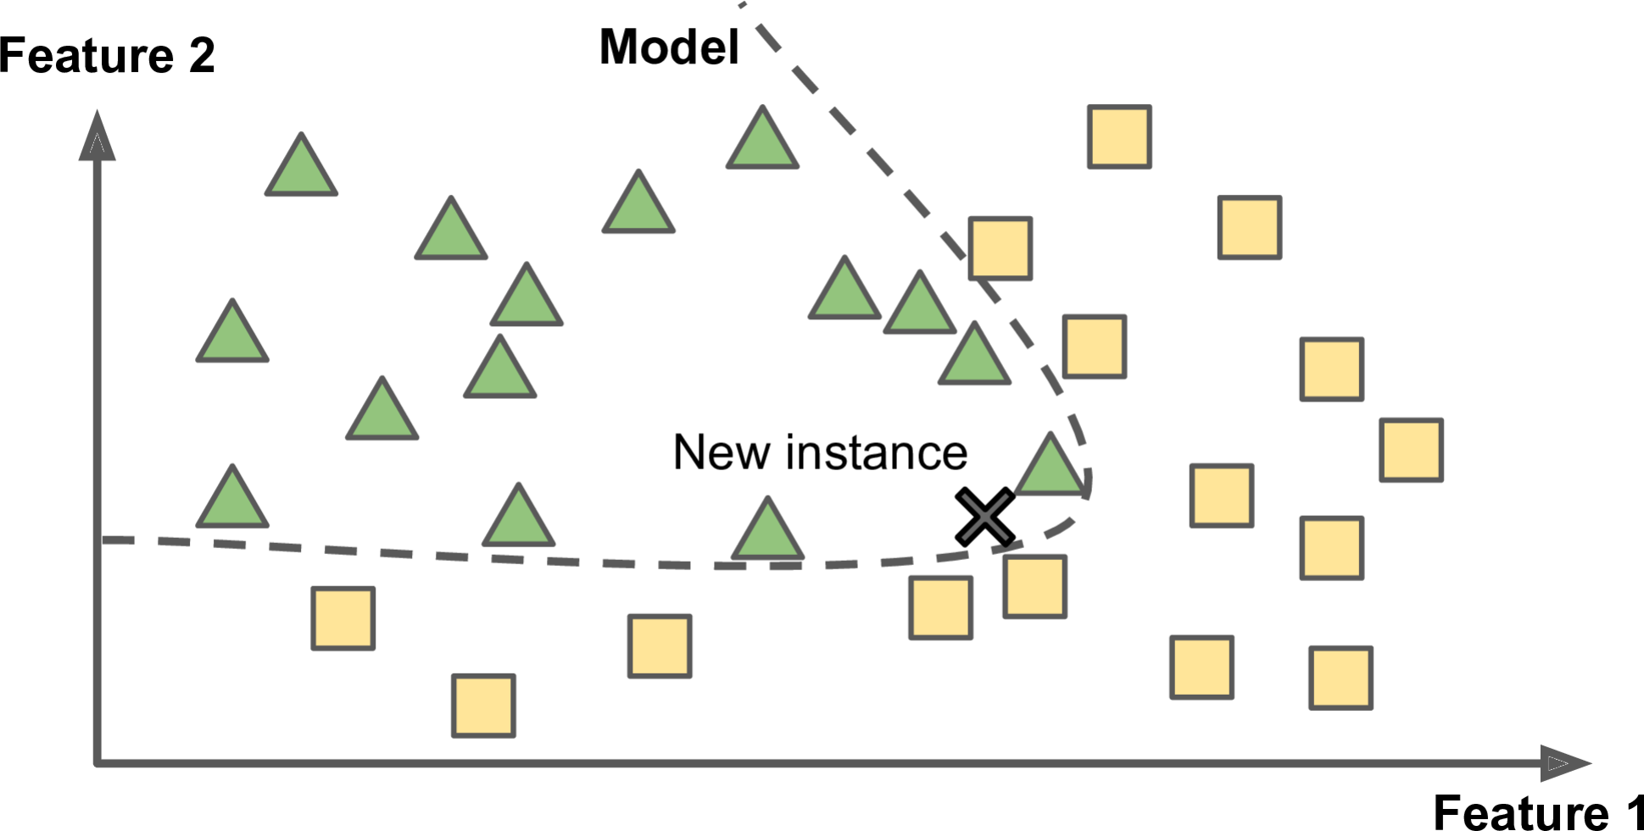

Use model?
Model-based learning: build a model of the learned examples.
Source: (Géron, 2019)

Slide 56



ML type combination

Slide 57
Of the following examples, which would you address using an unsupervised learning algorithm? (Check all that apply.)
Given email labeled as spam/not spam, learn a spam filter.
Given a set of news articles found on the web, group them into set of articles about the same story.
Given a database of customer data, automatically group customers into different market segments.
Given a dataset of patients diagnosed as either having diabetes or not, learn to classify new patients as having diabetes or not.
Source: Andrew Ng

